Slide 1
Preventing Vertical Transmission & Care for the Pregnant Woman with HIV Module 4 Zoom Activities

Slide 2
#1: Fishbone activity Objective: Illustrate factors leading to low EID rates using a fishbone diagram (QI)

Slide 3
Review
Preventing mother to child transmission (PMTCT) is an integrated approach to service delivery to:
Prevent pregnant women who are HIV- from acquiring HIV during pregnancy or breastfeeding
Ensure pregnant women with HIV are maintained on effective ART from pregnancy through delivery and breastfeeding
Minimize the risk of transmission at delivery through various obstetric approaches
Ensure HIV-exposed newborns receive appropriate prophylactic ART
Early infant diagnosis (EID) is critical to early initiation of lifesaving treatment and all healthcare providers can play a role in encouraging mothers to have their babies tested.
WHO recommends infants born to mothers with HIV should be tested for HIV-1 DNA between 4 and 6 weeks of age.
Children should have a repeat HIV DNA test at 18 months and/or when breastfeeding ends, whichever one is later, to provide the final infant diagnosis.

Slide 4
Fishbone Diagram practice
A Fishbone Diagram “graphically displays the relationship of the causes to the effect and to each other, helping teams identify areas for improvement”¹
In your group, you will fill out a fishbone diagram to ascertain reasons why EID rates in your clinical setting are low or nonexistent.
1. Institute for Healthcare Improvement Patient Safety Essentials Toolkit

Slide 5
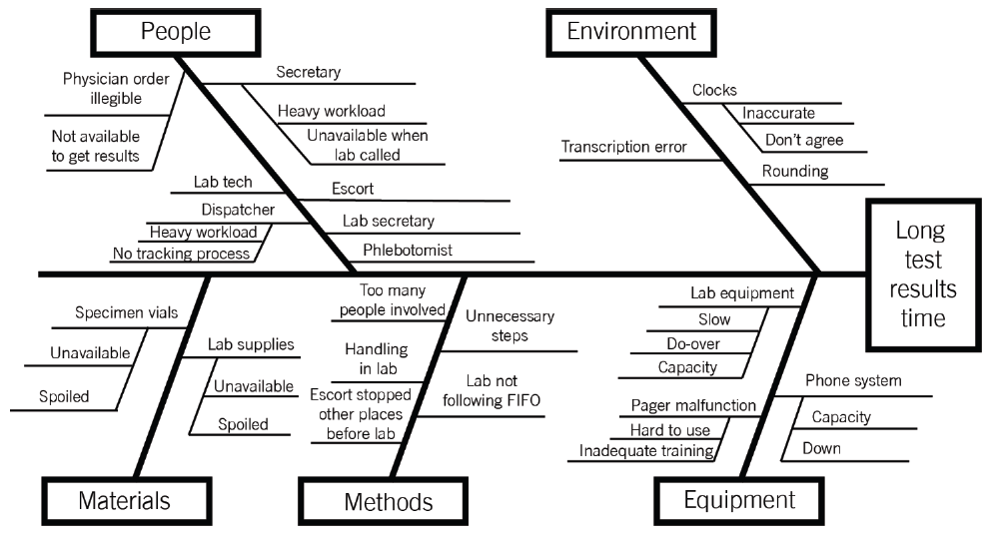
Example of a Fishbone Diagram

Slide 6
Fishbone Diagram
People
Environment/Workplace
Low or non-existent
EID rates
Materials/Supplies
Methods
Equipment

Slide 7
Breakout rooms
15 minutes

Slide 8
What causes did you discuss?
People
Environment/Workplace
Low or non-existent
EID rates
Materials/Supplies
Methods
Equipment
→ What might the solutions be?

Slide 9
Possible causes
People
Parent/caregiver lack of information/not aware of EID
Parent/caregiver avoiding EID due to concerns about stigma
Inability to reach parent post-partum
Provider lack of knowledge of EID
Provider not offering/recommending EID
Health professional, phlebotomist or lab technician may not be present to either obtain sample or run the test
Environment/workplace
HIV stigma/discrimination in communities
Transportation network is disrupted
Difficult for parent/caregiver to come for EID
Difficult for laboratory to send sample or obtain materials/supplies
Laboratory is closed
Material/supplies
Point-of-care (POC) EID not available or not on site
Reagents not available or expired
Blood draw supplies not available or expired
DBS cards not available
Methods
High costs
Providers may not be aware of protocol
Information system slow for return of results or lengthy turnaround time
Protocol for EID has not been standardized at your institution
Protocol for indeterminate results does not exist
Equipment
Lab machine to test this is not operational
Lab machine to run this test is not available at clinical setting
No Gene Xpert at this facility
HIV DNA PCR technology outdated

Slide 10
#2: Multidisciplinary discussion Objective: Discuss the unique needs of mothers and newborns related to HIV

Slide 11
Multidisciplinary discussion questions
Describing the challenges that women with a new infant and new diagnosis may face
Explaining possible solutions to these challenges that you can contribute from the standpoint of your own health profession
Identifying community resources that may also help address these challenges

Slide 12
Breakout rooms
10 minutes

Slide 13
Reflection

