Slide 1
Pre-Exposure Prophylaxis and Care for Men Who Have Sex with Men Module 11 Zoom Activities

Slide 2
#1: Multidisciplinary discussion Objective: Recognize the underlying prejudice toward key populations, including provider bias.

Slide 3
Stigma and discrimination
S&D is experienced by key populations
Health professionals have biases, even if we are unaware of them
Our biases can adversely affect clinical outcomes

Slide 4
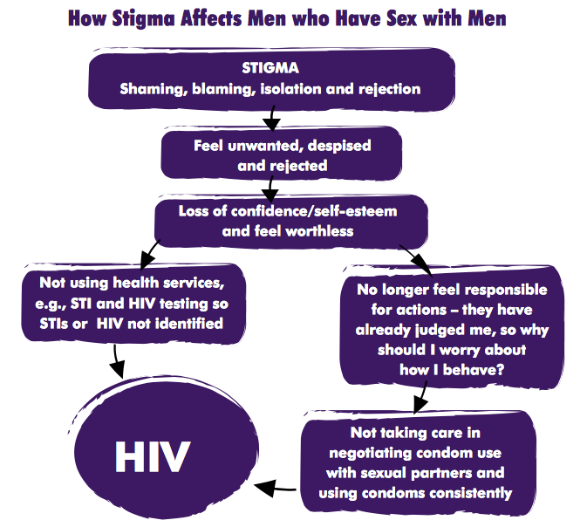
How can we as health professionals challenge S&D?
How might you address each point along the flowchart within your professional role?
Source: USAID, Pact Inc, and ICRW. Understanding and challenging stigma toward men who have sex with men: toolkit for action. 2010.

Slide 5
Breakout rooms
10 minutes

Slide 6
Reflection
What solutions do you suggest to address stigma and discrimination?

Slide 7
#2: Taking a Sexual History role play Objective: Demonstrate how to take a sexual history using the 5 “P”s framework

Slide 8
Case
Lubanzi is a 25-year-old man who presented to the outpatient department (OPD) with painful defecation and anal discharge, which was concerning for an STI.

Slide 9
Role Play instructions
In pairs, take turns practicing taking a sexual history (3 minutes each)
Read the provider and patient scenarios from: “Learner Zoom Handout” (PDF in the LMS)

Slide 10
Breakout rooms
10 minutes

Slide 11
Return to breakout rooms to debrief with your partner:
How did this activity make you feel?
What went well?
What would you like to improve the next time you take a sexual history?

Slide 12
Breakout rooms
5 minutes

Slide 13
#3: Review Indications for PrEP Objective: Apply WHO guidelines to evaluate for PrEP eligibility

Slide 14
Indications for PrEP
HIV negative AND
Have a sexual partner with HIV who is not virally suppressed OR
Are sexually active in a high HIV prevalence population or geographical location AND who has had any of the following risk factors in the past 6 months:
Vaginal or anal sexual intercourse without a condom with more than one partner OR
A recent history of a STI by laboratory testing or self-report or syndromic STI treatment OR
Has used PEP for sexual exposure OR
Is requesting PrEP
People who inject drugs
Sex workers
SOURCE: WHO Implementation Tool for Pre-Exposure Prophylaxis (PrEP) of HIV Infection: Clinical (2017)

Slide 15
Breakout Room instructions
Imagine you are working in a primary care clinic that is administering a PrEP questionnaire to all patients. Review two sample patients to determine if those patients are candidates for PrEP
Materials needed:
Learner Zoom Handout
WHO PrEP technical brief
Figure 1 from the WHO Implementation Tool for PrEP

Slide 16
Breakout rooms
10 minutes

Slide 17
Who is eligible for PreP?
Patient A: A 55-year-old man who has had condomless sex with three female sex workers in the last 6 months (but none in the last month). He has had Gonorrhea twice in the last year and syphilis once. He has hypertension and chronic kidney disease with a creatinine clearance of 25. | ?
Patient B: A 20-year-old woman with one partner over the last year. This partner is HIV-positive and she does not know if he is on treatment. She has never had an STI. She is estimated to be 12 weeks pregnant and has not had sex in 6 weeks. She would like to be on PrEP if you think it is indicated. | ?
Patient C: A 42-year-old woman with one male partner for the last year. She had syphilis in her twenties and no other STIs since. Her partner tested negative for HIV at a community health fair last year. She does not think he has other sexual partners. | ?
Patient D: A 27-year-old woman with 5 male partners in the last 3 months. She has not used condoms with any of them. She last had sex around 1-2 weeks ago and recently developed fevers, a sore throat, and swelling in the lymph nodes of her neck. She has no medical problems and was treated for Chlamydia last year. | ?

Slide 18
Who is eligible for PreP?
Patient A: A 55-year-old man who has had condomless sex with three female sex workers in the last 6 months (but none in the last month). He has had Gonorrhea twice in the last year and syphilis once. He has hypertension and chronic kidney disease with a creatinine clearance of 25. | No, due to creatinine level and chronic kidney disease
Patient B: A 20-year-old woman with one partner over the last year. This partner is HIV-positive and she does not know if he is on treatment. She has never had an STI. She is estimated to be 12 weeks pregnant and has not had sex in 6 weeks. She would like to be on PrEP if you think it is indicated. | Yes
Patient C: A 42-year-old woman with one male partner for the last year. She had syphilis in her twenties and no other STIs since. Her partner tested negative for HIV at a community health fair last year. She does not think he has other sexual partners. | Unlikely now, but could be in the future
Patient D: A 27-year-old woman with 5 male partners in the last 3 months. She has not used condoms with any of them. She last had sex around 1-2 weeks ago and recently developed fevers, a sore throat, and swelling in the lymph nodes of her neck. She has no medical problems and was treated for Chlamydia last year. | Yes, but acute HIV should be excluded before starting PrEP

