Slide 1
COVID-19 Vaccines & Vaccine Hesitancy Module 19 Zoom Activities

Slide 2
#1: Vaccine recommendation discussion Objective: Review the vaccine recommendations for different groups, including people living with HIV, pregnant women, and those with prior history of COVID-19

Slide 3
Case
Amara is a 27-year-old woman who presented with her 3-year-old son and asked about medications to prevent COVID-19. After learning about the COVID-19 vaccine, she chose to be vaccinated. One month later, she returned with her 20-year-old sister. Her sister had COVID-19 three months ago and asked if she should still be vaccinated.

Slide 4
Small group Qs – Who should get vaccinated?
Amara’s 20-year-old sister had COVID-19 three months ago. Should she be vaccinated or not?
You find out that Amara’s sister is in her first trimester of pregnancy. Should she be vaccinated or not?
Amara shares that her 30-year-old friend has HIV and asks if she should be vaccinated as well. Should Amara’s friend be vaccinated or not?
You can find these questions in your Zoom handout

Slide 5
Breakout rooms
10 minutes

Slide 6
Debrief

Slide 7
Key Points
Patients with a history of COVID-19 should still be vaccinated
Pregnancy is not a contraindication to vaccination and vaccination is recommended during pregnancy
Vaccination is highly recommended for patients who are immunocompromised to prevent infection

Slide 8
#2: Barriers to vaccine dissemination (IPE) Objective: Discuss the major barriers to equitable COVID-19 vaccine dissemination

Slide 9
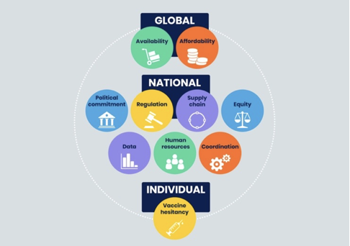
Barriers to vaccine dissemination

Slide 10
Small group discussion
1. Discuss a barrier to vaccination you have experienced or observed in your health profession. How has that barrier impacted you and your patients? How might that barrier be addressed?
2. How does vaccine equity relate to the historical context of colonialism and public health in Africa?

Slide 11
Breakout rooms
10 minutes

Slide 12
Debrief on barriers

Slide 13
#3: Vaccine hesitancy role play Objective: Apply the principles of motivational interviewing to engage vaccine-hesitant patients in conversations about vaccination

Slide 14
Case continues
In the module, Amara shared that her brother was hesitant to be vaccinated due to concerns about the side effects of the vaccine.
Vaccine hesitancy refers to a delay in vaccination or refusal of vaccination despite access to vaccines.

Slide 15
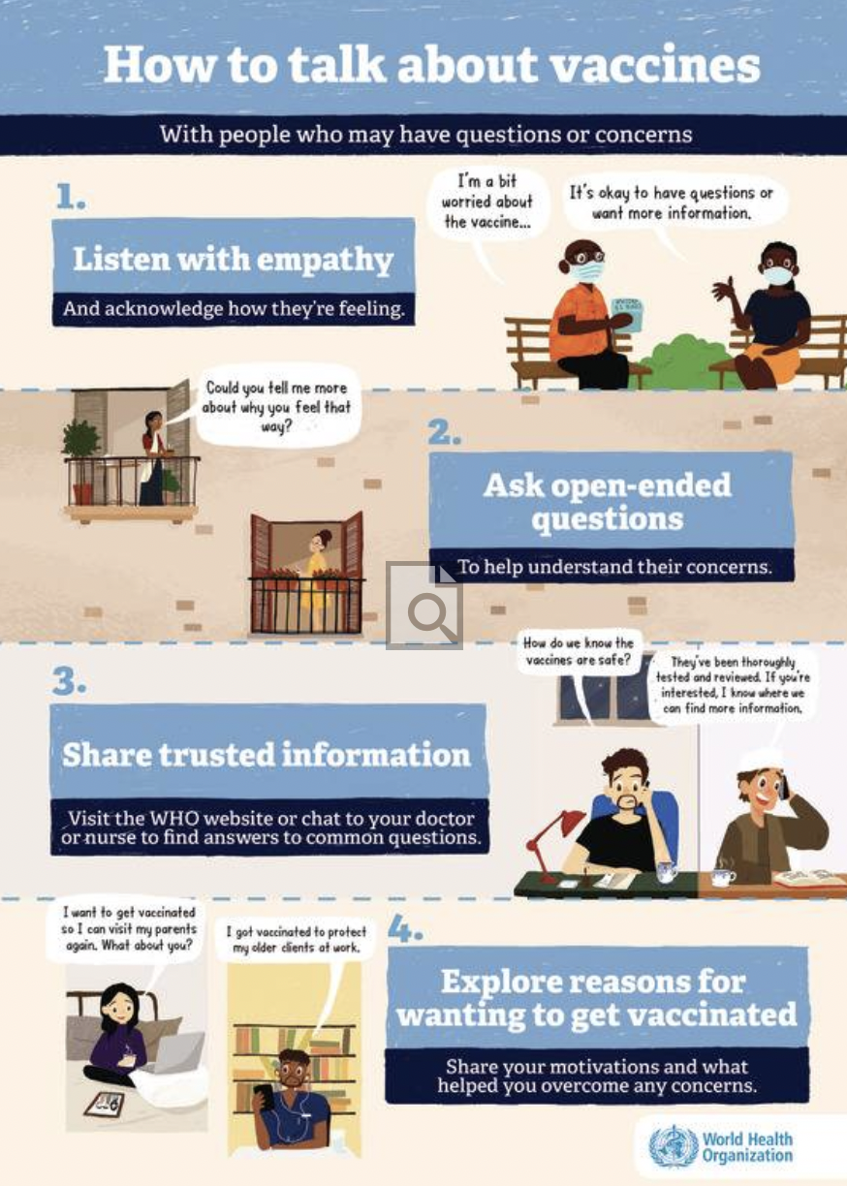
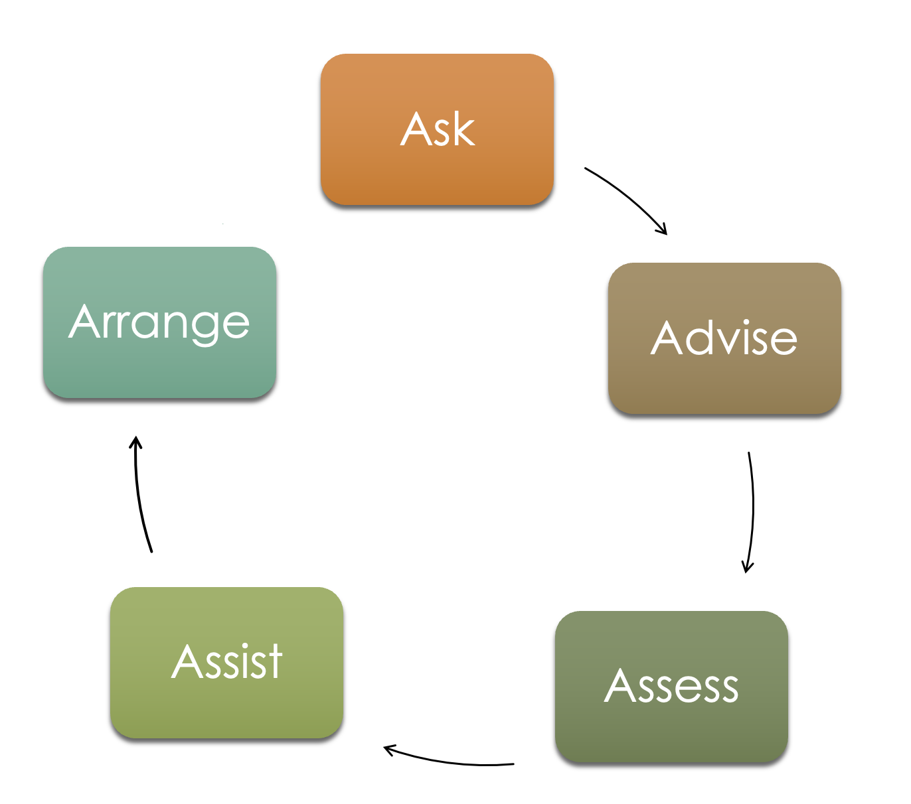
Motivational Interviewing

Slide 16
Role Play Instructions
In pairs, take turns playing the role of Amara’s brother and the provider. As the provider, practice motivational interviewing techniques.
After spending 5 minutes each practicing, take 5 minutes to discuss what worked well and what you would improve.
Refer to the Zoom and WHO handouts for instructions when in your breakout room.

Slide 17
Breakout rooms
15 minutes

Slide 18
Reflection
What went well?
What was challenging?
Patients, how did you feel the interaction went?
Providers, how would you change your approach next time?

