Slide 1
Community-Based HIV Service Delivery Module 14 Zoom Activities

Slide 2
#1: Discussion Objective: Recognize challenges in delivering high quality care at the patient and health system levels

Slide 3
Small Group Instructions
In small groups, take 15 minutes to review the perspectives of the 3 cases and answer the questions on your handout with the goal of developing strategies to address the challenges faced by each of the cases:
Patient with HIV (Kwabena)
HIV Manager
HIV Nurse
Refer to the Zoom handout when in your breakout room (located on the course site)

Slide 4
Breakout rooms
15 minutes

Slide 5
Report out

Slide 6
Final Reflection
Considering the HIV manager, HIV nurse, and Kwabena, is there a way to deliver optimal care for Kwabena?
What would be the challenges of implementing a strategy that meets Kwabena’s needs?
What short, medium and long-term interventions might address the priorities for the patient Kwabena, the HIV manager, and the HIV nurse?

Slide 7
#2: Discussion Objective: Compare and contrast various community-based HIV service delivery models (IPE)

Slide 8
Examples of Community-based HIV service delivery models
Medication adherence clubs
Community ART Groups (CAGs)
Harm reduction clinic (Mauritius)
“Points de distribution communautaires” (PODIs) [Communiy-based points of ART distribution]

Slide 9
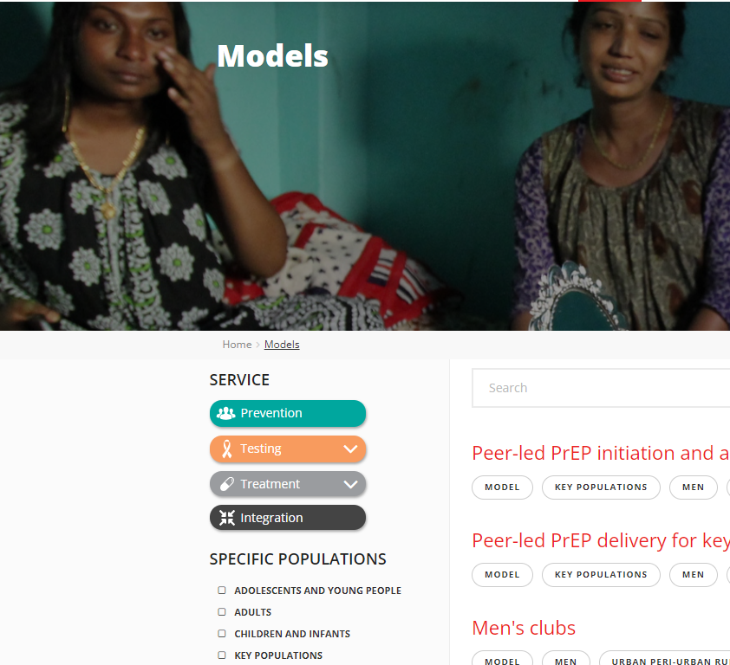
Small group model assignments
Medication adherence clubs
Community ART Groups (CAGs)
Harm reduction clinic (Mauritius)
“Points de distribution communautaires” (PODIs) [Communiy-based points of ART distribution]
Select a new model at differentiatedservice delivery.org

Slide 10
Breakout rooms
10 minutes

Slide 11
Debrief
Compare/contrast the different service delivery models
Vote on preferred model
How can HIV care delivery be improved in your community?

Slide 12
#3: QI practice Objective: Discuss how to evaluate the effectiveness of differentiated service delivery models (QI)

Slide 13
Case continues
For Kwabena, a patient stable on ART, we discussed that less frequent clinical visits and medication pickups (every 3-6 months for multi-month supplies) would reduce his barriers to care.
For Mercy, we discussed decentralizing HIV care close to her home would improve her access to care.
After differentiating HIV care for Kwabena and Mercy, how do we assess if quality of care has improved?

Slide 14
Quality Assessment
How could you go about assessing whether the quality of care provided for Kwabena improved?
What data could you use to assess care quality in each example?
Complete the table on your Zoom handout
Patient-level metrics | System-level metrics

Slide 15
Breakout rooms
10 minutes

Slide 16
Debrief
How would you assess if quality improved?
What patient-level and system-level metrics would you use?

Slide 17
Possible answers
Patient-level metrics | System-level metrics
Number of patients with suppressed viral rates. Note: It is important to strive for and use viral suppression rates in quality improvement for HIV care, but some lower-level facilities may not be able to monitor viral loads. Thus, it is essential to determine other metrics of treatment success and have a clear idea of the kind of ‘stable’ patients that could be transitioned to monitoring in settings where viral load monitoring is not available. Time patients spend with the nurse in the clinic encounter Patients’ satisfaction with having to visit less frequently | Actual vs. expected clinic visit rates Average waiting time for patients in the clinic waiting room Nurse quality of life assessment (based on her business in clinic), staff satisfaction surveys Staffing models, staffing requirements Rates of continuity of treatment Loss to follow up

